Slide 1
Data Engineering
Capstone Project-1
Created By:
Nikunj Tomar

Slide 2
Business Objectives
Exploratory Data Analysis of provided Data Set.
Using the data set to come up with meaningful insights.
Using Machine Learning to come up with the various reasons for the employees leaving the company.

Slide 3








Technology Stack Used
MySQL (to create database)
Linux Commands
Sqoop (Transfer data from MySQL Server to HDFS/Hive)
HDFS (to store the data)
Hive (to create database)
Impala (to perform the EDA)
SparkSQL (to perform the EDA)
SparkML (to perform model building)

Slide 4
Data Set Used
Various CSV data files used:
Departments
Department Managers
Department Employees
Employees
Salaries
Titles

Slide 5
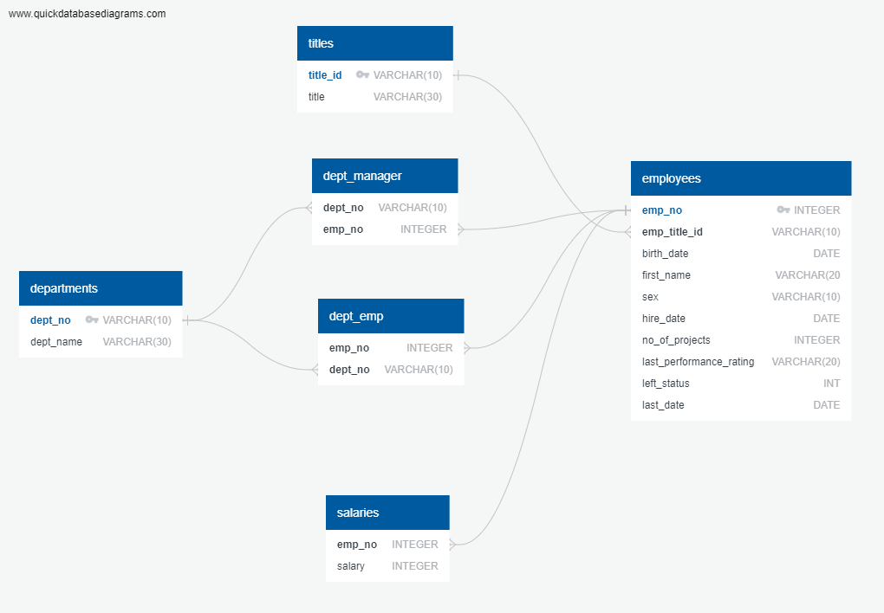
Data Model

Slide 6
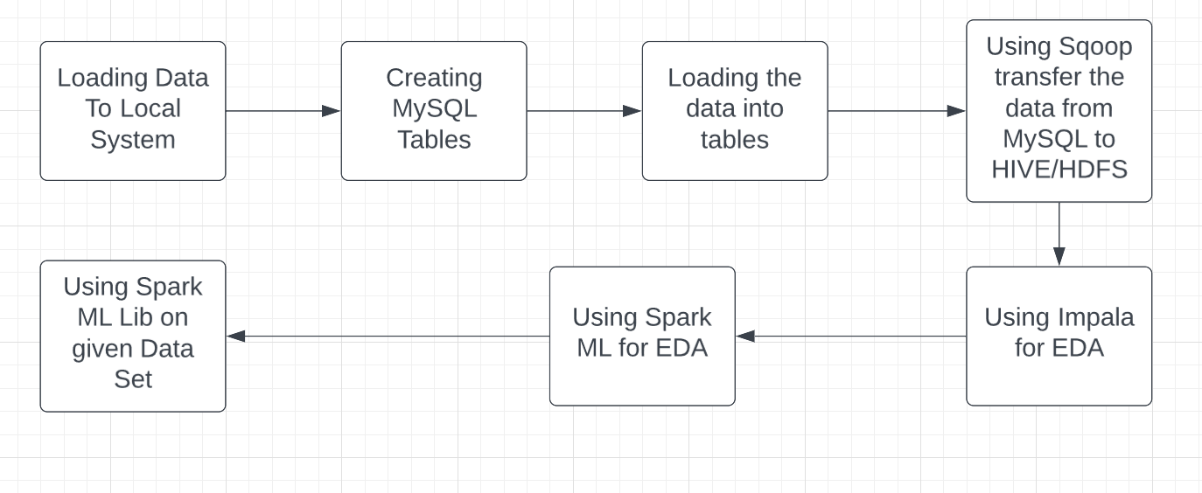
Pipeline Architecture

Slide 7
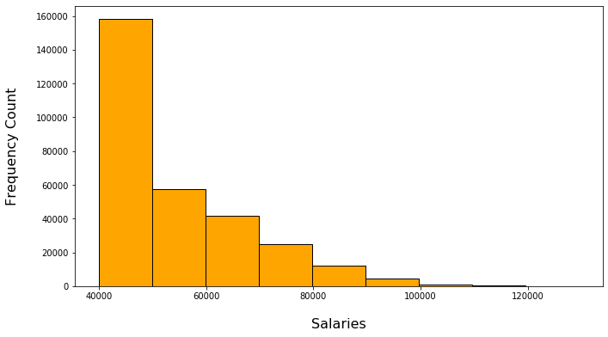
Outputs
Salary Distribution among the Employees.

Slide 8
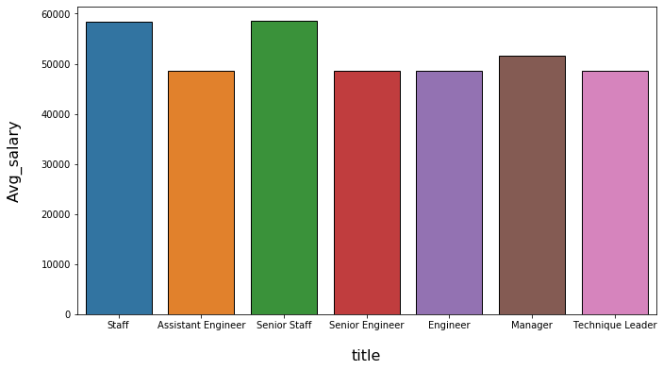
Average Salary Title Wise.

Slide 9
Title Distribution among the Employees.

Slide 10
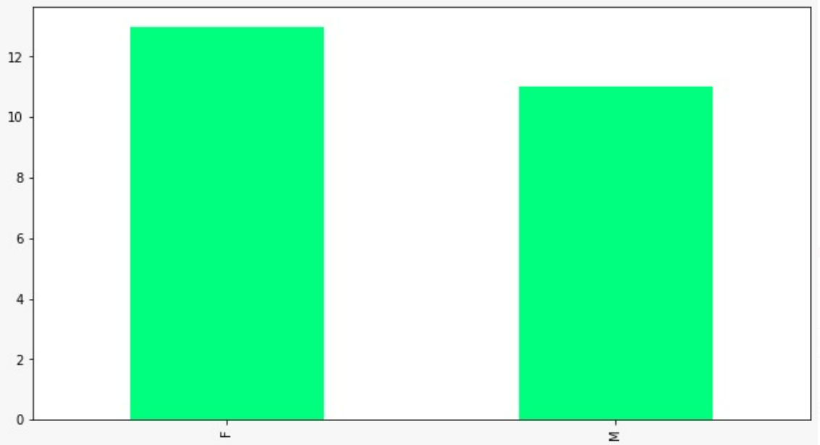
Male and Female Managers.

Slide 11
Machine Learning Model
Outcomes
Random Forest Classifier is used.
The accuracy obtained is 90.02%.
Parameters | Value
Accuracy | 0.9002268488178656
Error | 0.09977315118213437
Precision | 0.8104083793325443
Recall | 0.9002268488178656
F1 Score | 0.8529596135710857

Slide 12
Challenges Faced
Importing Data from Local to MySQL.
Data Transfer using SQOOP.
Using ML Lib for Machine Learning.

Slide 13
Steps Ahead
The analysis can be used by the company to access its employee retention.
The analysis can be used to find out the reasons why employees are leaving the company.
The reasons found out may be used to rectify the problems.

Slide 14
Thank You

